Slide 1



Data Analytics
Social Buzz
2022 June
Notes:
Hello and welcome, my name is Zhiheng Wang and today I will be presenting to you the results of the Data Analytics task.

Slide 2


Today's agenda
Project recap
Problem
The Analytics team
Process
Insights
Summary
Notes:
Today's agenda will be as follows:
1. We will recap the overall project to give a high level understanding of the business problem we're tackling and the specific requirements.
2. We will dive into the specific problem that we, the Data Analytics team, have been focusing on and will give some background as to why this is such a big problem.
3. After introducing the problem, I will go over the team responsible from our side in tackling this task.
4. I will then go over the high-level process that we followed to complete this task, so that you have complete clarity in how we tackle these kinds of tasks.
5. Finally, I will go over all the important results and I will present them as a series of insights and visualizations from our analysis.
To wrap up, I will summarize and open for any questions.

Slide 3

Subject
3-month pilot with Social Buzz
Background
Unicorn company that reached huge scale in a short time
Tasks
Audit of big data practice and sharing best practices and industry expertise
Guiding you through a successful IPO with our deep expertise and knowledge
Find insights in data analysis to conclude the 5 most popular categories of content
Project Recap
Notes:
To kick things off let me recap this engagement.
We, Accenture have embarked on a 3 month pilot with Social Buzz to focus on 3 main tasks, aligned with some of the biggest challenges that you're currently facing.
Social Buzz has reached huge scale in recent years to become recognized as a global unicorn company. We are here to help you manage this scale and to guide you in the right direction.
Firstly, we will be doing an audit of your big data practice and sharing best practices and industry expertise. Secondly we will be guiding you through a successful IPO, of which we have deep expertise and knowledge of within our team. And finally, we have conducted an analysis of your data to find insights regarding your top 5 most popular categories of content

Slide 4





Problem
Understand the audience behind the data to provide a more personalized and enjoyable experience
How to capitalize such big amount of data?
Vast amount of data
Notes:
Focusing on the last point that I mentioned there, this is what the Data Analytics team has been specifically focused on.
Clearly with such grand scale, this comes with a lot of data and with such vast amounts of data comes challenges.
To give a background on how much data you've been creating:
- You told us that your platform receives over 100 000 posts per day which amounts to 36 500 000 posts every year, of which, this is all unstructured data making it very hard to make sense of.
In this day and age, content is king. Just look at some of the biggest platforms in the world, for example YouTube, Facebook and Netflix... they are all content businesses...
But how to capitalize on it when there is so much?
It's not just all about harvesting as much content as possible... The real value is in understanding and crunching this content to gain a deeper understanding of your audience and to therefore provide a more personalized and enjoyable experience.
And this is where our data analytics expertise comes in, with the insights that we've uncovered from this task, we can show you exactly how to take analytics to production at scale.

Slide 5



Andrew Fleming
Chief Technical Architect
The Analytics team
Marcus Rompton
Senior data expert
Zhiheng Wang
Data Analyst
Notes:
Talking about experience, we have a large data analytics practice at Accenture but we had a team of 3 people primarily focusing on this task. Andrew Fleming is our Chief Technical Architect and his expertise really helped to guide the team to produce high quality analysis.
Marcus Rompton, a senior data expert has worked with the worlds biggest clients on solving their data problems and was heavily involved in the data engineering side of this project.
And finally myself, Zhiheng Wang, who was solely responsible for taking leadership guidance and delivering high quality insights from the raw datasets and turning these into business decisions.

Slide 6
Data understanding including data model and domain of your business.
Process
1
Data extraction by architecting an ideal dataset and extracting it from the relevant data sources.
2
Process and model this data into a dataset that can precisely answer the business questions and produce analytics.
3
4
Uncover insights from this dataset and to produce visualizations to describe the insights.
Unlock business decisions and make recommendations on next steps.
5
Notes:
So, how did we tackle this problem?
Well, we approached it in 5 steps:
1. Data understanding - the key to success on any data project is to understand the data in detail. So we took the time to understand the data model and domain of your business.
2. Data extraction - after understanding your business, we then architected what an ideal dataset should look like for this problem and extracted it from the relevant data sources.
3. After extracting the raw data, we needed to process and model this data into a dataset that can precisely answer the business questions and produce analytics.
4. With our new dataset, we used our analytical expertise to uncover insights from this dataset and to produce visualizations to describe the insights.
5. And finally we used these insights to unlock business decisions and to make recommendations on next steps.

Slide 7

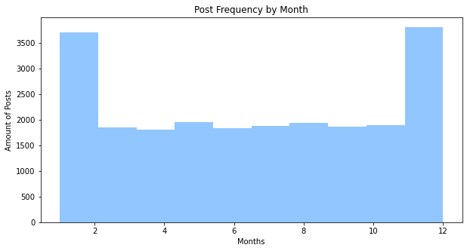
Insights
Unique Categories
Most Posted Category
Most Posted Month
Total of 16 unique categories of posts
There was 1738 posts from just the Animals category alone
The most common month for users to post within was December to January due to holiday season
Notes:
From your data we found that you had a total of 16 unique categories of posts across your sample dataset. This includes things such as Animals, Science, and Healthy Eating
As well as this, there was 1738 posts from just the Animals category alone! People obviously really like aminals!
And also the most common month for users to post within was December to January holiday season, as you can see on the bottom chart, this is interesting to know that people are most active during this time!
But now, onto the main question... which is... what were the top 5 most popular categories of posts?

Slide 8
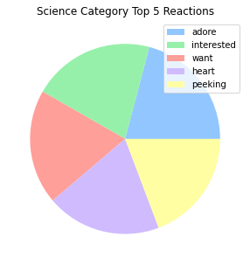
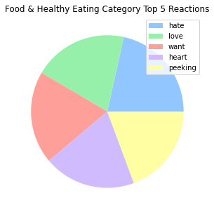
The top 5 most popular categories are:
Animals, Science, Healthy Eating, Technology, and Food.
The Animals category alone has 68624 aggregated popularity and 1738 posts.
Among the top 5 most popular categories, science & technology, and healthy eating & food, are strongly related topics.
Observation from popular topics
We found that the users is more positive on the science & technology topic in general while having love-hate opinions on the food topic. Shown on the pie charts.
Grouping the topics
Recommendation
This present an opportunity for your platform to focus news feeds on inventions and breakthroughs.
Also involve more diversified recipes to engage the audience more.
Notes:
From our analysis you can see that the top 5 most popular categories of posts were Animals, Science, Healthy Eating, Technology, and Food in descending order.
Animals had an aggregate popularity score of almost 68624. It is very interesting to see some related topics in the top 5. Now let’s group the topics.
Among the top 5 most popular categories, science & technology, and healthy eating & food, are strongly related topics.
We found that the users is more positive on the science & technology topic in general while having love-hate opinions on the food topic. Shown on the pie charts.
This present an opportunity for your platform to focus news feeds on inventions and breakthroughs.
Also, for the foodies out there, to involve more diversified recipes to engage the audience more.

Slide 9
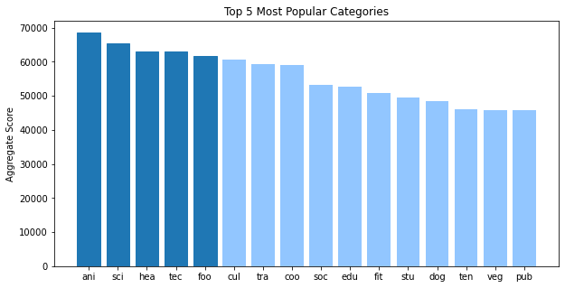
Popularity level split
This shows that the categories sorted by popularity is weighted towards categories at the top
Between the 8th category and the 9th category there exabits a clear split
Greedy Effect
The popular ones gets more popular while the less popular ones die down
Notes:
Additionally, you can see from this chart a big split of popularity between the top 8th and 9th categories.
This tells me that the categories sorted by popularity is weighted towards categories at the top. This means that it exhibits a "greedy" effect, the most popular categories get more popular whilst as you drop down the popularity rankings, you may see that they fall away drastically.

Slide 10

We found that Science and Technology are very welcomed by the users. This presents a massive opportunity for Social Buzz to include more news feed.
We found that Food and Healthy Eating are among the most popular categories, and users posses conflicted opinion on them, suggesting that users may want to see more diversified recipes and such related feed
We would like to help you further in real time.
Summary
Notes:
So to summarize:
We tackled this task and found the top 5 most popular categories as asked, but we also went one step further.
We found that Science and Technology are very welcomed by the users. This presents a massive opportunity for Social Buzz to include more news feed.
We found that Food and Healthy Eating are among the most popular categories, and users posses conflicted opinion on them, suggesting that users may want to see more diversified recipes and such related feed
As much as this analysis was insightful, we are ready to take it to the next stage and we have the expertise within Accenture to help you realize these kinds of insights in production across your organization and in real time. We would love to help you with this.

Slide 11

Thank you!
ANY QUESTIONS?
Notes:
Thank you very much for listening, please feel free to ask any questions that you may have!

